Slide 1
REAL-TIME MACHINE LEARNING MODELS FOR EARLY SEPSIS DETECTION USING CONTINUOUS PATIENT DATA MONITORING
Student Name:
Student ID:
Professor Name:
Submission Date:

Slide 2
1. Introduction
Sepsis is a life-threatening condition that requires early detection and timely intervention for survival.
Machine learning algorithms offer a promising approach to predict sepsis outcomes and improve clinical decision-making.
Accurate prediction models help healthcare providers efficiently allocate resources and manage patient care.
This study evaluates various machine learning models to predict sepsis outcomes and enhance clinical workflows.
Notes:
Sepsis is a life-threatening condition, requiring early detection for survival. Machine learning algorithms present a promising solution to predict sepsis outcomes and improve clinical decision-making. Accurate prediction models enable healthcare providers to allocate resources efficiently and manage patient care effectively. This study evaluates various machine learning models to predict sepsis outcomes and optimize clinical workflows.

Slide 3
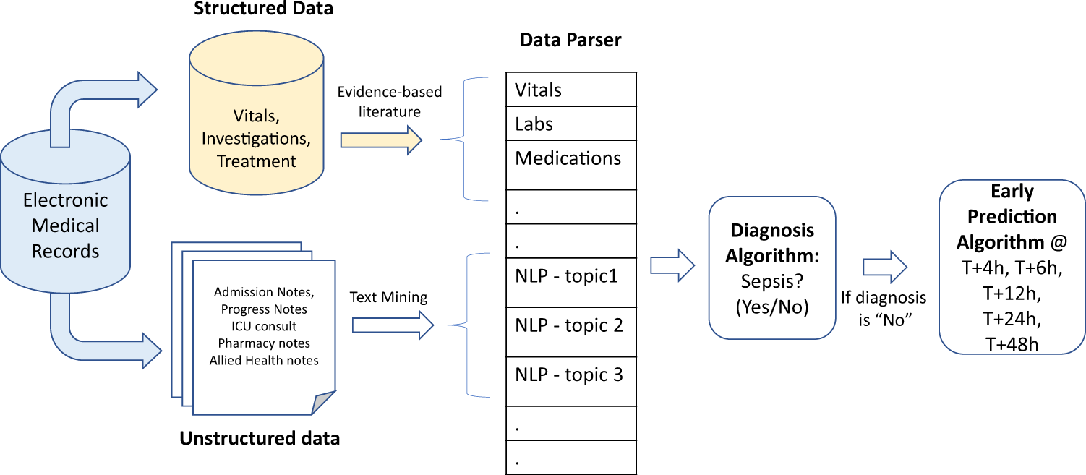
2. Problem Statement
Predicting sepsis outcomes is critical but challenging due to the life-threatening nature of the condition and urgency of intervention.
Imbalanced datasets in sepsis prediction models can lead to biased results, particularly for minority classes like deceased patients.
Accurate predictions are essential in healthcare for timely interventions, reducing mortality, and optimizing resource allocation.
Current models face difficulties in distinguishing between survivors and deceased patients, affecting model reliability and clinical applicability.
Notes:
Predicting sepsis outcomes is crucial due to the life-threatening nature and urgent intervention needed. Imbalanced datasets pose challenges, leading to biased results, especially for deceased patients. Accurate predictions are vital for timely interventions, reducing mortality, and optimizing resource allocation. However, current models struggle to effectively distinguish between survivors and deceased patients, impacting their reliability and clinical use.

Slide 4
3. Research Objectives
To develop and implement real-time Random Forest and XGBoost models for continuous monitoring of patient vital signs and lab results to detect early signs of sepsis.
To evaluate model performance using Area Under the ROC Curve (AUC) and Precision-Recall metrics, ensuring accurate early detection while minimizing false positives.
To compare model outputs with standard clinical sepsis scoring systems, such as SOFA and qSOFA, and assess improvements in early detection timing and accuracy.
To recommend further improvements in model design and implementation, focusing on data collection methods, feature selection, and integration strategies for enhancing clinical applicability and effectiveness in sepsis prediction.
Notes:
The research aims to develop real-time Random Forest and XGBoost models for early sepsis detection using patient vital signs and lab results. Performance will be evaluated through ROC AUC and Precision-Recall metrics, comparing the models to SOFA and qSOFA scores. The goal is to improve early detection, accuracy, and clinical applicability, with recommendations for enhancing data collection and model design.

Slide 5
4. Research Questions
How effective are Random Forest and XGBoost models in detecting early signs of sepsis using continuous monitoring of patient vital signs and lab results, compared to existing clinical scoring systems like SOFA and qSOFA?
What is the predictive accuracy of the Random Forest and XGBoost models for early sepsis detection, as measured by the Area Under the ROC Curve (AUC) and Precision-Recall metrics?
In what ways do machine learning models reduce false positives in sepsis detection, and how does this impact clinical decision-making compared to standard methods like SOFA and qSOFA?
What improvements in data collection, feature selection, and integration strategies are necessary to optimize real-time machine learning models for early sepsis detection in clinical settings?
Notes:
This research explores the effectiveness of Random Forest and XGBoost in early sepsis detection, comparing them to clinical systems like SOFA and qSOFA. It evaluates model accuracy using ROC AUC and Precision-Recall metrics. The study also examines how machine learning reduces false positives and identifies improvements in data collection, feature selection, and integration for enhancing clinical applications of sepsis detection.

Slide 6
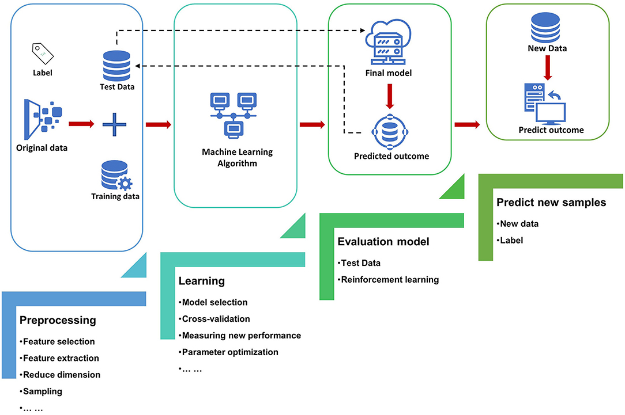
5. Literature Review
Moor et al. (2021) reviewed studies applying machine learning for early sepsis prediction in ICU, highlighting inter-study variability and model effectiveness.
Fleuren et al. (2020) conducted a meta-analysis showing machine learning models' AUROC ranges from 0.68 to 0.99 for ICU sepsis prediction.
Bedoya et al. (2020) validated a deep learning model, outperforming traditional methods, with a C-statistic of 0.88 for sepsis detection.
Sendak et al. (2020) demonstrated successful integration of a deep learning sepsis model, Sepsis Watch, into clinical care, improving early detection.
Notes:
Recent studies highlight the potential of machine learning for early sepsis detection in ICUs. Moor et al. (2021) noted variability in model effectiveness. Fleuren et al. (2020) found AUROC ranges from 0.68 to 0.99. Bedoya et al. (2020) validated a deep learning model with a C-statistic of 0.88. Sendak et al. (2020) showed successful clinical integration of Sepsis Watch, improving early detection.

Slide 7
6. Methodology
The dataset consists of 38,760 samples, representing sepsis patient outcomes, used for evaluating machine learning models.
Five machine learning models employed: Random Forest, XGBoost, Logistic Regression, Decision Tree, and K-Nearest Neighbors (KNN).
Evaluation metrics include accuracy, precision, recall, F1-score, ROC AUC, and PR AUC to assess model performance and class prediction.
ROC and PR AUC curves were used to measure the model's ability to differentiate between deceased and surviving patients.
Notes:
The dataset includes 38,760 samples, representing sepsis patient outcomes, to evaluate machine learning models. Five models—Random Forest, XGBoost, Logistic Regression, Decision Tree, and KNN—were assessed using accuracy, precision, recall, F1-score, ROC AUC, and PR AUC. ROC and PR AUC curves helped measure the models' effectiveness in distinguishing between deceased and surviving patients, providing insights into performance.

Slide 8
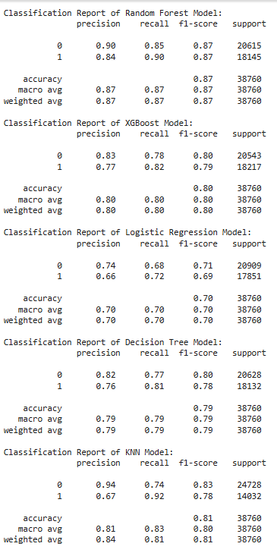
7. Results
Random Forest achieved the highest accuracy (87%) among all models, excelling in precision-recall balance for both classes.
XGBoost achieved an accuracy of 80%, performing slightly worse than Random Forest, particularly on imbalanced datasets.
Logistic Regression performed at 70% accuracy, struggling to correctly classify deceased patients, with lower recall values.
Decision Tree achieved 79% accuracy, but overfitting led to poor generalization and moderate precision-recall outcomes.
KNN showed an accuracy of 81%, but struggled with false positives and false negatives, limiting its clinical applicability.
Notes:
Random Forest achieved the highest accuracy (87%), with strong precision-recall balance. XGBoost followed with 80% accuracy, performing worse on imbalanced datasets. Logistic Regression had 70% accuracy, struggling with deceased patient classification. Decision Tree achieved 79%, but overfitting led to poor generalization. KNN had 81% accuracy but faced challenges with false positives and negatives, limiting clinical use.

Slide 9
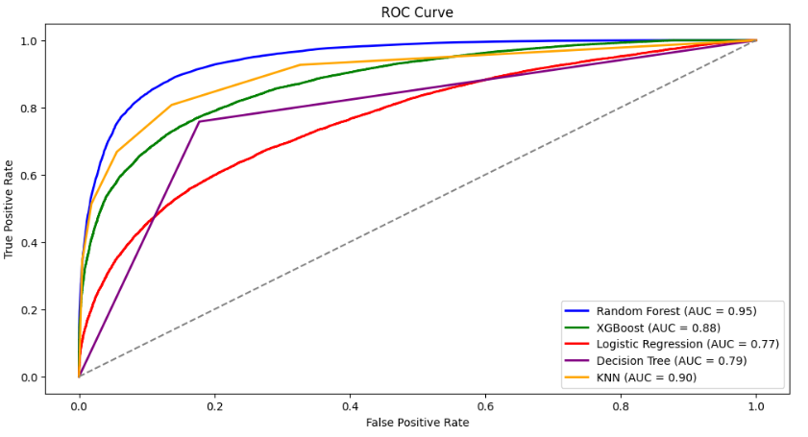
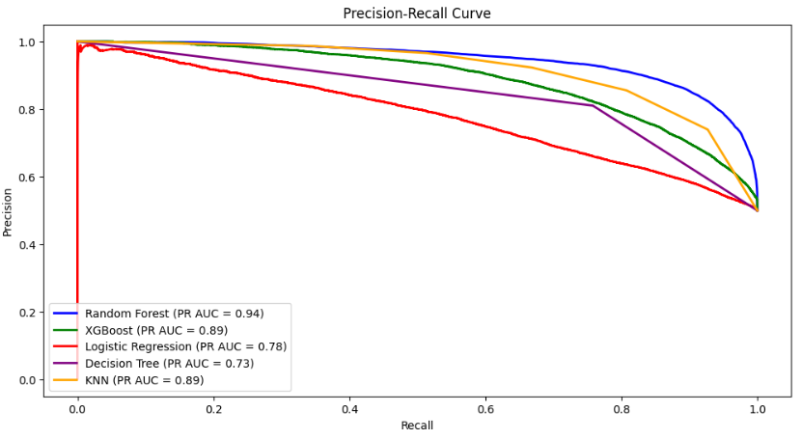
7. Results
Precision for Random Forest in class 0 (deceased) was 0.90, indicating strong predictive accuracy for the deceased.
Random Forest's recall for class 0 was 0.85, suggesting missed predictions for some deceased patients, which is a concern.
XGBoost's recall for class 0 was 0.78, indicating a higher miss rate (22%) for deceased patients compared to Random Forest.
KNN's precision for class 0 was 0.94, but it's recall was low at 0.74, which raised concerns in clinical settings.
Logistic Regression had poor recall (0.68) for class 0, significantly missing deceased patients, which could be dangerous.
Notes:
Random Forest showed strong precision (0.90) for predicting deceased patients but had a recall of 0.85, missing some cases. XGBoost had a recall of 0.78, missing 22% of deceased patients. KNN had high precision (0.94) but low recall (0.74), raising concerns. Logistic Regression struggled with recall (0.68), significantly missing deceased patients, which poses clinical risks.

Slide 10
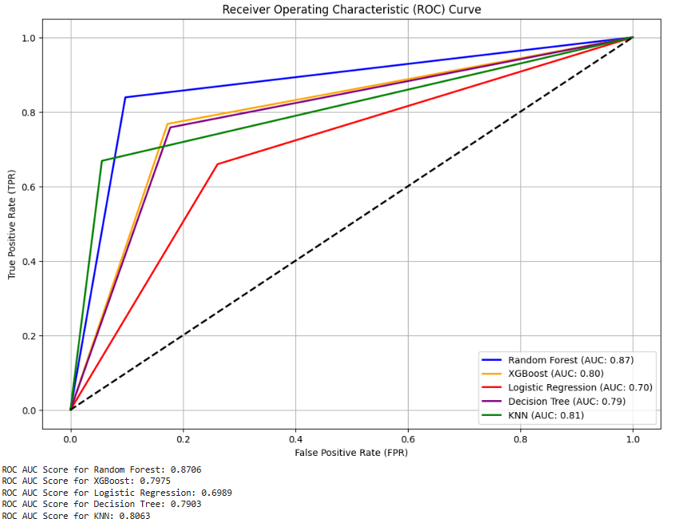
7. Results
Random Forest's ROC AUC was 0.8706, outperforming all other models in distinguishing between deceased and surviving patients.
PR AUC for Random Forest was 0.94, showing excellent recall performance on the minority class (deceased patients).
Random Forest significantly outperformed SOFA and qSOFA in distinguishing deceased from survivors, with ROC AUC of 0.8706 vs 0.70-0.80 for SOFA and qSOFA.
PR AUC for Random Forest (0.94) was also superior to SOFA and qSOFA, highlighting its better performance for identifying deceased patients in imbalanced datasets.
Notes:
Random Forest outperformed all models with a ROC AUC of 0.8706, effectively distinguishing deceased from surviving patients. Its PR AUC of 0.94 demonstrated strong recall for deceased patients. Compared to SOFA and qSOFA, which had ROC AUCs between 0.70-0.80, Random Forest showed superior performance, especially in identifying deceased patients within imbalanced datasets, making it highly effective for sepsis prediction.

Slide 11
8. Conclusion
Random Forest outperformed all models, achieving the highest accuracy and best precision-recall balance for predicting sepsis outcomes.
XGBoost performed slightly worse than Random Forest, especially in handling imbalanced data, requiring further tuning for better results.
Logistic Regression and Decision Tree struggled with lower accuracy and recall, making them less effective for clinical sepsis predictions.
KNN showed decent accuracy but had significant issues with false positives and false negatives, limiting its clinical utility.
Notes:
Random Forest outperformed all models, achieving the highest accuracy and optimal precision-recall balance for sepsis predictions. XGBoost showed slightly lower performance, particularly with imbalanced data, and requires further tuning. Logistic Regression and Decision Tree had lower accuracy and recall, reducing their clinical effectiveness. KNN had decent accuracy but struggled with false positives and negatives, limiting its clinical applicability.

Slide 12
Reference List
Moor, M., Rieck, B., Horn, M., Jutzeler, C.R. and Borgwardt, K., 2021. Early prediction of sepsis in the ICU using machine learning: a systematic review. Frontiers in medicine, 8, p.607952.
Fleuren, L.M., Klausch, T.L., Zwager, C.L., Schoonmade, L.J., Guo, T., Roggeveen, L.F., Swart, E.L., Girbes, A.R., Thoral, P., Ercole, A. and Hoogendoorn, M., 2020. Machine learning for the prediction of sepsis: a systematic review and meta-analysis of diagnostic test accuracy. Intensive care medicine, 46, pp.383-400.
Bedoya, A.D., Futoma, J., Clement, M.E., Corey, K., Brajer, N., Lin, A., Simons, M.G., Gao, M., Nichols, M., Balu, S. and Heller, K., 2020. Machine learning for early detection of sepsis: an internal and temporal validation study. JAMIA open, 3(2), pp.252-260.
Sendak, M.P., Ratliff, W., Sarro, D., Alderton, E., Futoma, J., Gao, M., Nichols, M., Revoir, M., Yashar, F., Miller, C. and Kester, K., 2020. Real-world integration of a sepsis deep learning technology into routine clinical care: implementation study. JMIR medical informatics, 8(7), p.e15182.

